Slide 1


BUSINESS EXCAVATORS
HOSTILE TAKEOVER SAGA
MINDTREE LOOSES ITS MIND!!
MADE BY;
AAYUSHI JAISWAL

Slide 2



CONTENTS
• Introduction
• SWOT Analysis
• Problem Identification
• Proposed Solutions
• Best Solution
• Impact of the takeover
• Suggestions & Lessons learnt
• References

Slide 3



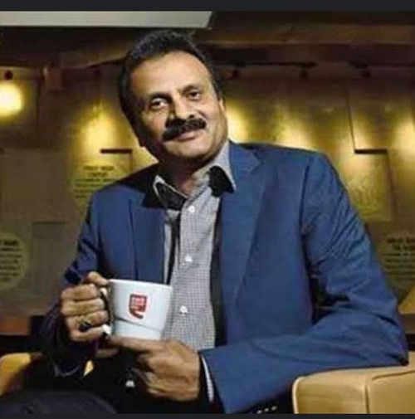

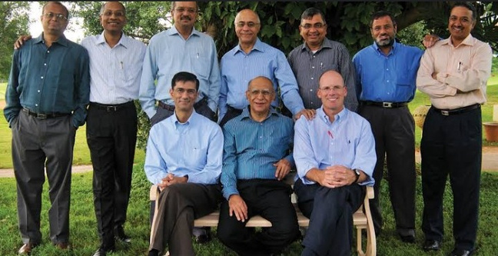
https://images.app.goo.gl/bChRALhQerMXrPZL7
Introduction of Mindtree
• Established in 1999 by 10 ex employees of renowned companies like Wipro, Cambridge tech, etc.
• 11th largest IT company in India.
V.G.Siddharta
Co-founders of Mindtree

Slide 4

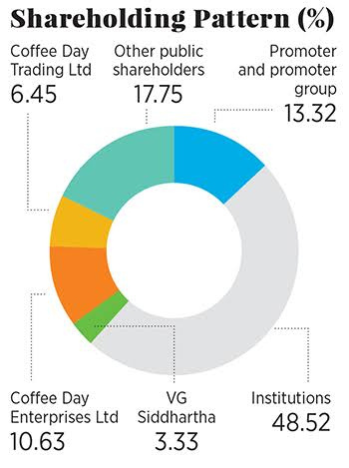

SHARES DISTRIBUTION
OF MINDTREE
V.G.Siddharta
combinely held
20.41%
Shares distribution

Slide 5
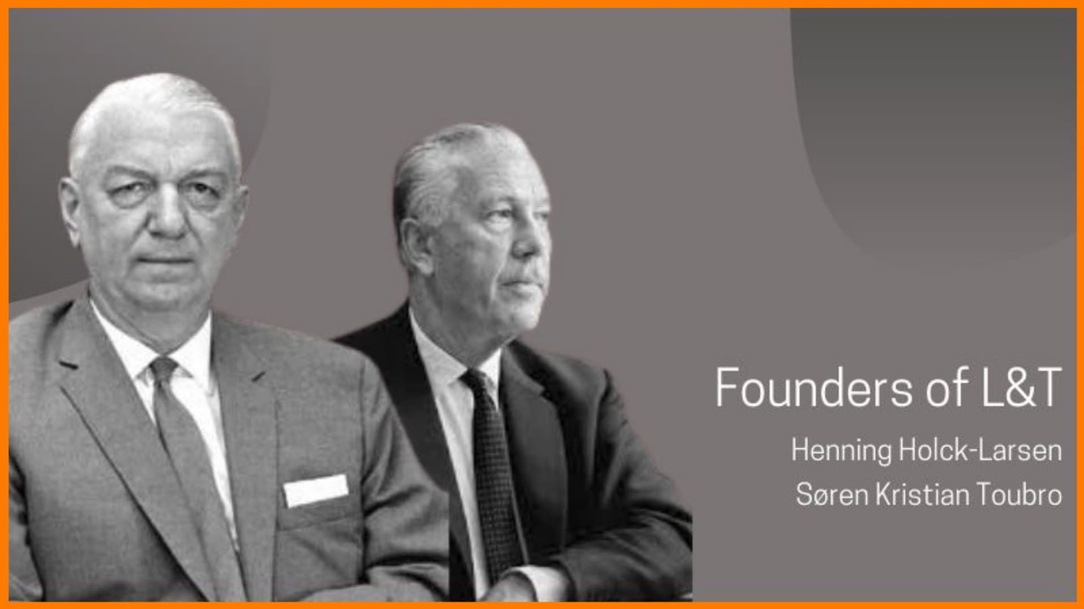

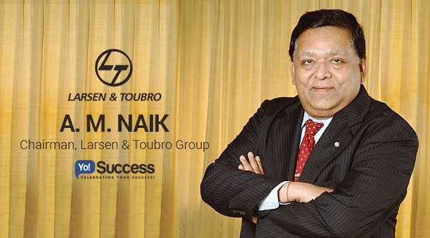
Introduction of
Larsen and Tubro
https://images.app.goo.gl/PpQLHQ1NkSUtaEws9
Established in 1938 by Henning Holck Larsen and Soren Kristian Tubro.
L&T
A.M.Naik

Slide 6
CASE AT A GLANCE!
1st Hostile Takeover in IT sector of India!
January 2019
May 2022
September 2017
Where it all started
May 2019
The grand merger
Initial phase
V.G.Siddharta first thought to sell his shares of Mindtree.
I step towards the takeover
Merger of L &T and Mindtree.
V.G.Siddharta started going into debts.
L&T bought shares of Mindtree through bidding.

Slide 7
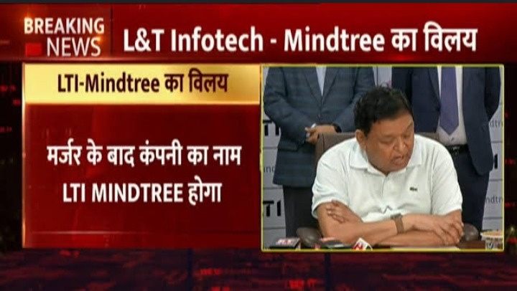

Slide 8



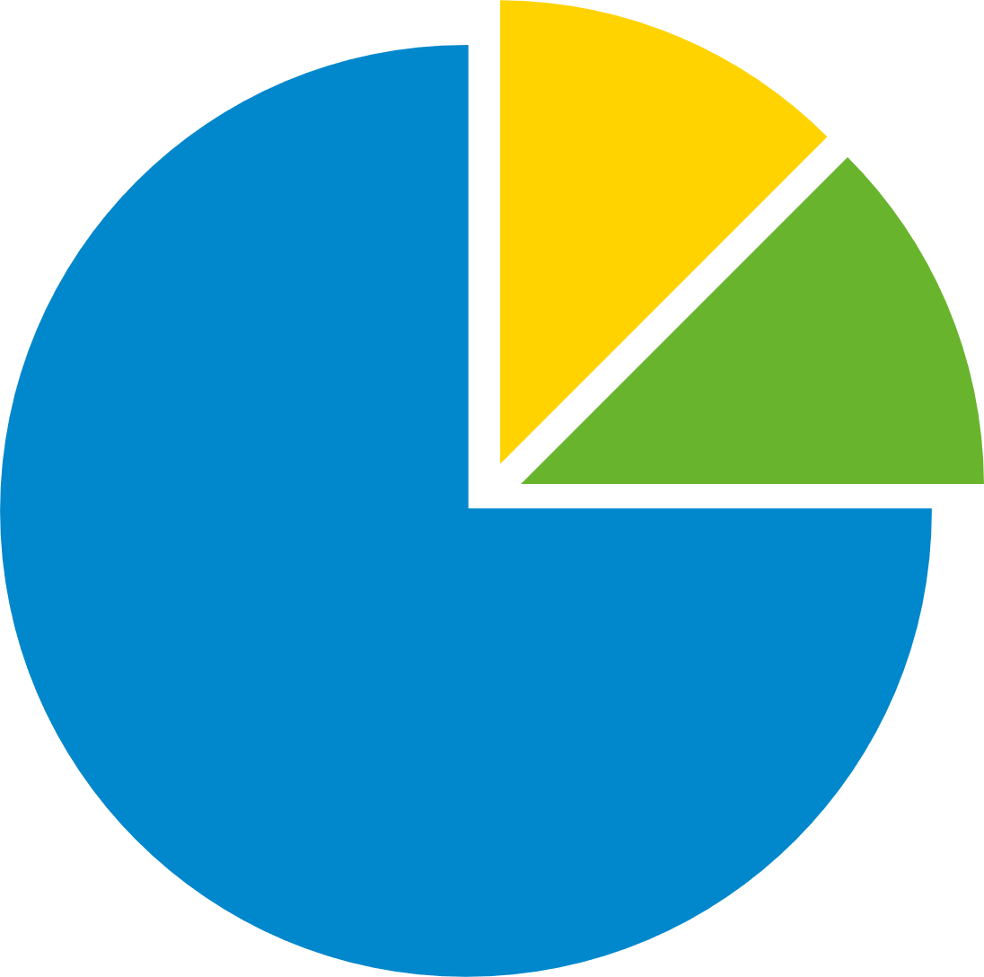

RESEARCH METHODOLOGY
Primary Research
Secondary Research
Survey

Slide 9



SWOT
ANALYSIS
OF
MINDTREE
Strengths
Weakness
• Experienced
workforce
• Focused at a
particular market.
• Poor distribution
of shares
Opportunities
Threats
• Digitalization
• Increase in demands
of softwares and
programmes
• Foreign international investors
• Foreign portfolio investors

Slide 10

PROBLEM IDENTIFICATION
Distribution of shares
Mindtree
_________
_________
___
Majority of
shares were
with FII
Only 13% stakes were with promoters.
Share holders were untrustworthy

Slide 11
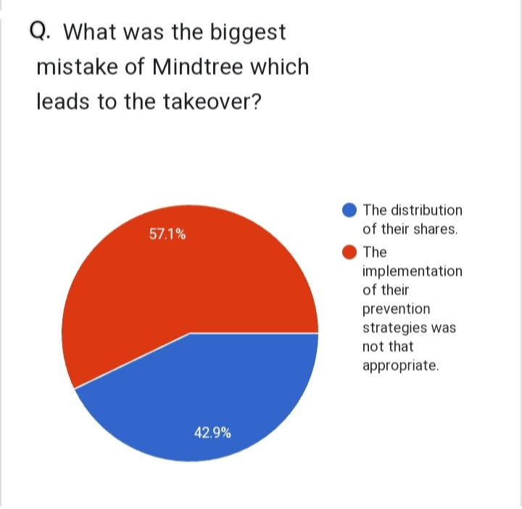
PROBLEM
IDENTIFIED
through
our
research

Slide 12
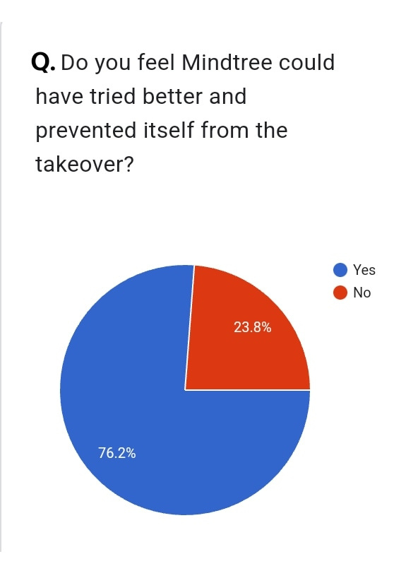
According to primary
research analysis
Mindtree could have been prevented itself!
But.....
HOW??

Slide 13

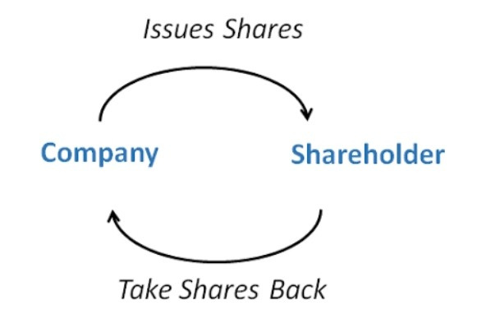



PROPOSED SOLUTIONS
White knight
Buyback
friendly company purchases
the target company instead
of the unfriendly bidder
when a corporation
purchases its owner
shares in the stock market

Slide 14
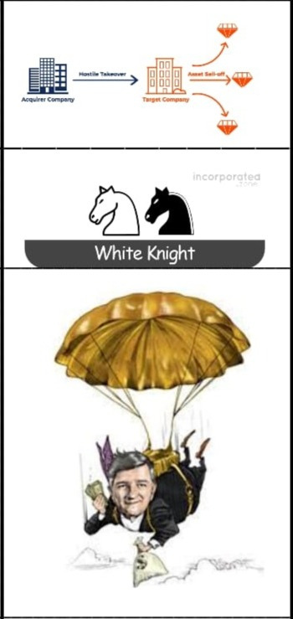

Crown jewel
Among the good,
best is always ONE!
White knight
Golden parachute

Slide 15
BEST SOLUTION
White knight strategy with correct implementation !

Slide 16
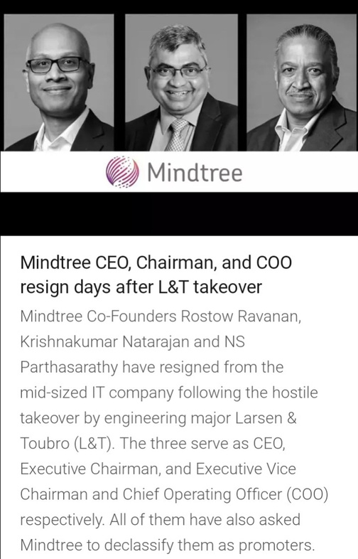
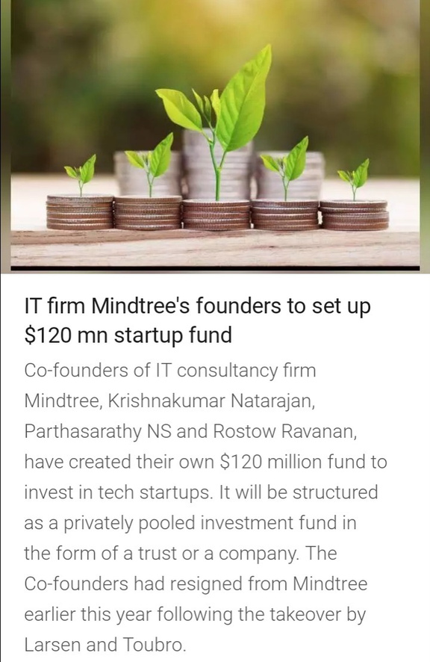

IMPACT OF THE TAKEOVER
1.
Livemint newspaper
Inc24 tech media

Slide 17
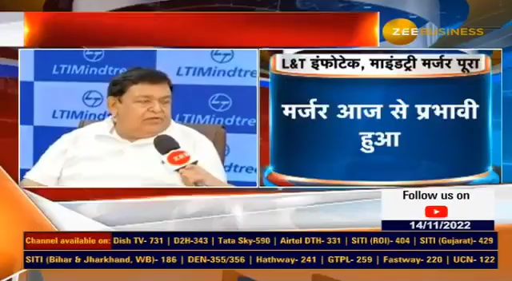
3.

Slide 18
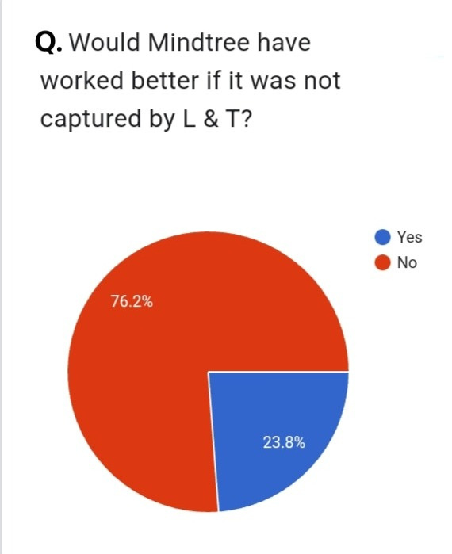
LTI Mindtree became
5th largest company
of India
3.
According to primary research analysis
people also think that takeover was
for the good of the Mindtree

Slide 19


SUGGESTIONS
• Find a trustworthy company OR partner.
• Remove any KMP (Key management personnel).

Slide 20

LESSONS LEARNT
• With experienced workforce,
knowledge of correct implementation of plans is also important.
• One should hold its majority shares with itself.

Slide 21
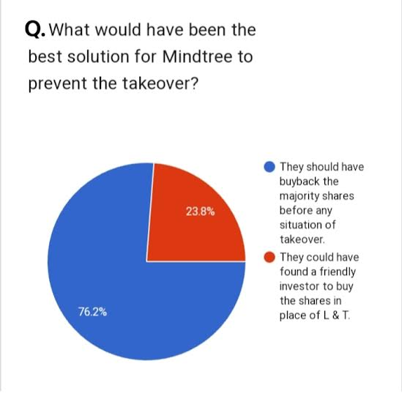
According to primary research analysis
"Prevention is better
than cure "

Slide 22
References
•https://timesofindia.indiatimes.com/business/india-business/mindtree-lt-info-merge-will-form-6th-largest-it-services-company/articleshow/91387005.cms 07-May
•https://en.wikipedia.org/wiki/Larsen_%26_Toubro#:~:text=Larsen%20%26%20Toubro%20originated%20from%20a,of%20dairy%20and%20allied%20equipment. 25 November 2022, at 23:4
•https://www.edukating.com/blog-the-takeover-saga--hostile-or-friendly-45.php 27-Aug-2022
•https://www.livemint.com/companies/news/with-60-stake-l-t-completes-its-hostile-takeover-of-mindtree-1561536743325.html 27-Jun-2019
•https://m.economictimes.com/news/company/corporate-trends/lt-boss-am-naik-appointed-as-mindtree-non-executive-chairman/articleshow/70264591.cms 17-Jul-2019

Slide 23
THANK YOU

